Slide 1
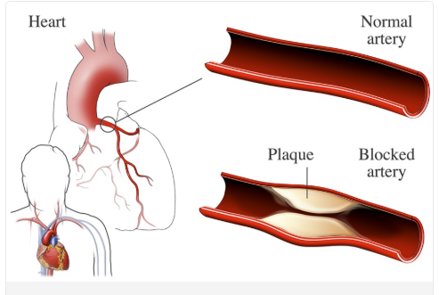
Disparities in Ischemic Heart Disease in
Oklahoma state
Ischemic heart disease is a type of heart disease that occurs when the arteries of the heart cannot deliver enough oxygen rich blood to the heart muscle due to narrowing from the buildup of fatty deposits called plaque.
It is also sometimes called coronary artery disease or Coronary heart disease.
Plaque buildup
Plaque buildup in the arteries is called atherosclerosis.
The buildup causes the arteries to harden and become
narrower over time. This can lower or block blood flow
to the heart muscle.
https://www.nhlbi.nih.gov/health/coronary-heart-disease

Slide 2
Quick Fact: Coronary heart disease affect women differently
Research Area
Working on CDC Wonder Mortality Data (Year 2018-23)
Center of Disease Control and Prevention
(https://wonder.cdc.gov/ucd-icd10-expanded.html)
Examining deaths from ischemic heart disease by Gender (Male & Female) which encompasses the following ICD-10 codes: I20-I25.
Study area : Oklahoma State US
Research Objective : Evidence based Intervention
Hormone changes may affect a woman’s risk for coronary heart disease.
The size and structure of the heart is different for women and men.
Women are more likely to have heart disease in the tiny arteries of the heart, called coronary microvascular disease.
https://www.nhlbi.nih.gov/health/coronary-heart-disease/women

Slide 3
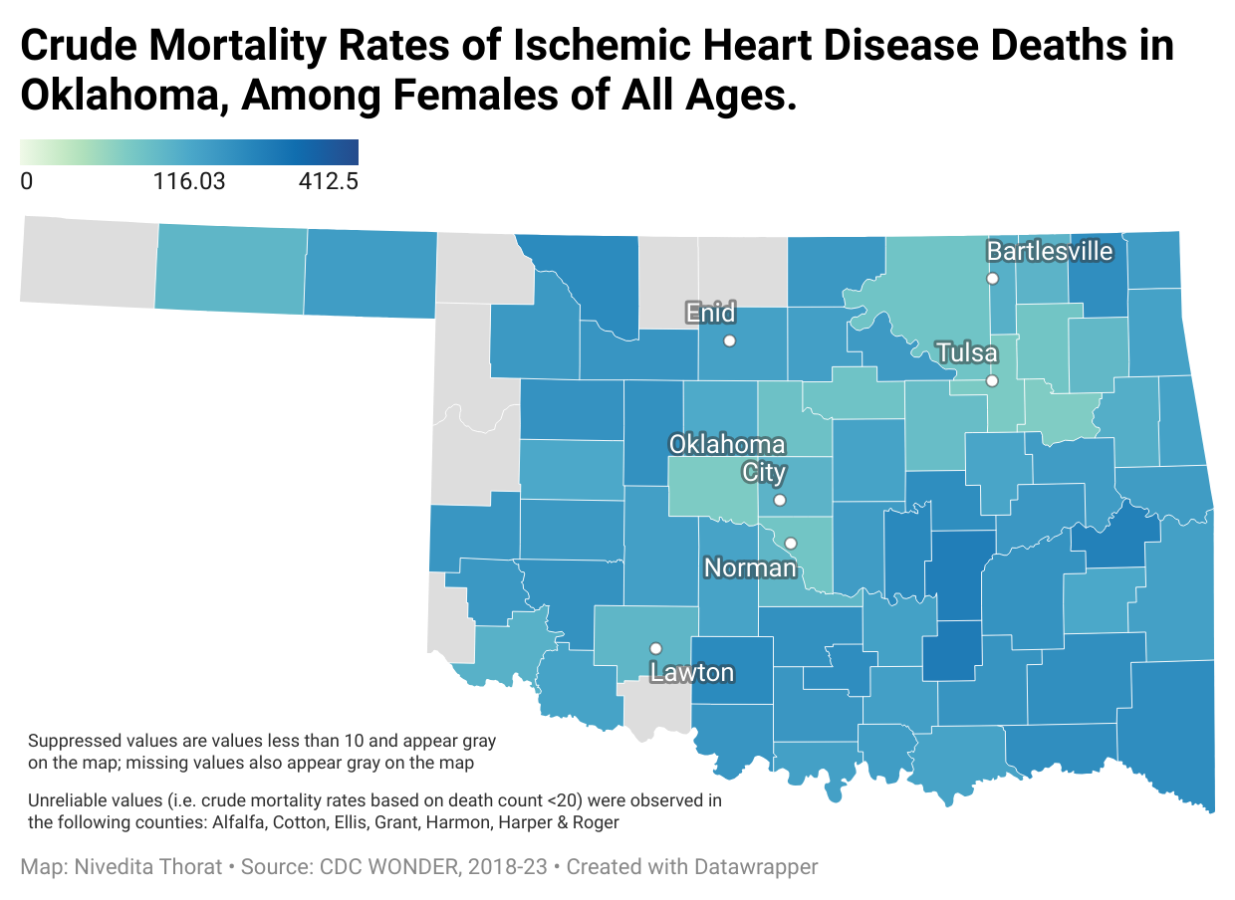
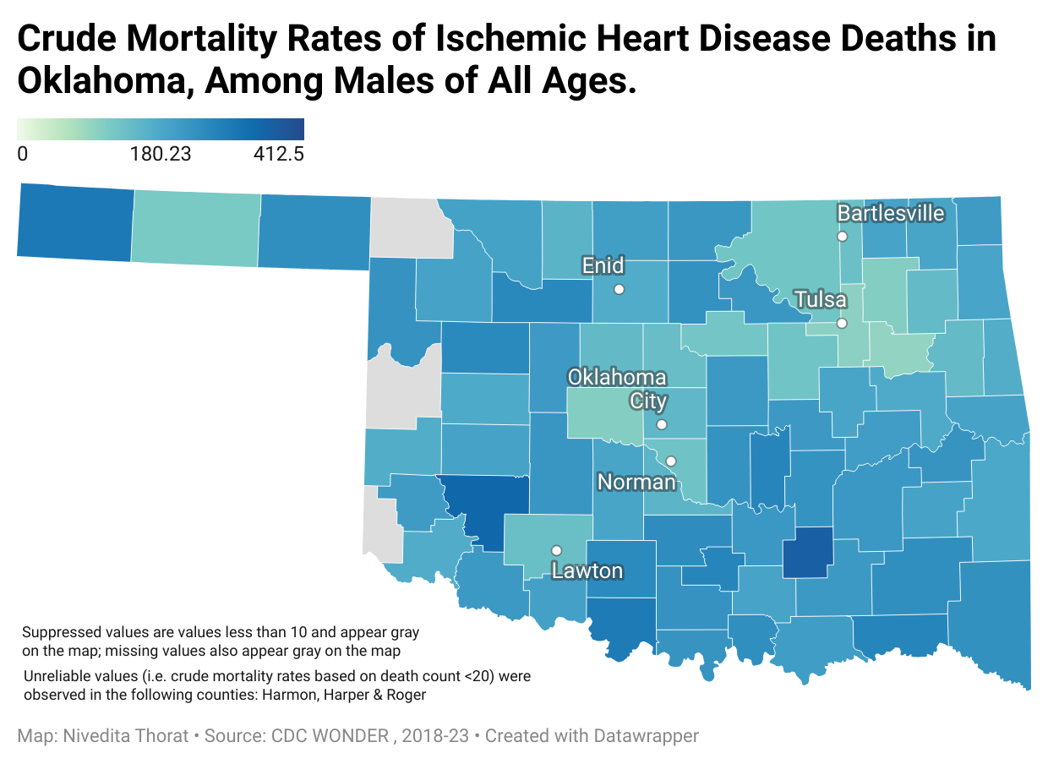
Primary county of concern
 | Female | Male
Population | 16286 | 16171
CMR | 257.9 | 358.7
The Choropleth map highlights Coal as the county with the highest crude mortality rate for both genders. That is the significant reason to choose Coal County for further investigation.

Slide 4
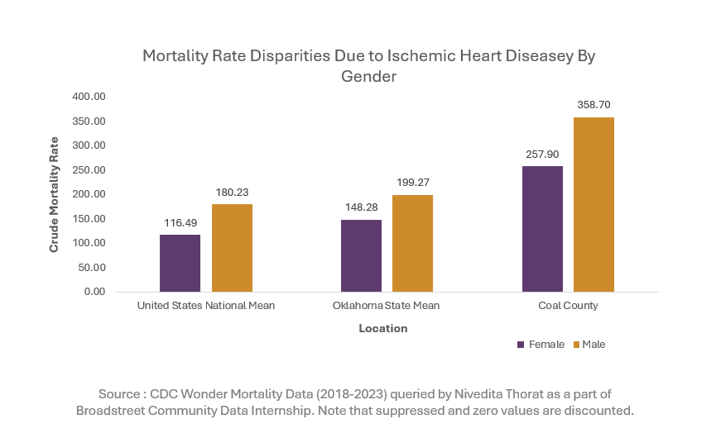
Crude Mortality rate of US, Oklahoma state and a Coal county
The highest incidence of Female and Male deaths occur in the Coal county.
Quick Fact:
The county with the highest crude mortality rate previously recorded is also a coal county.
Male mortality rates are consistently higher across coal county, it suggests that men are at greater risk, possibly due to lifestyle, biological, or occupational factors.

Slide 5
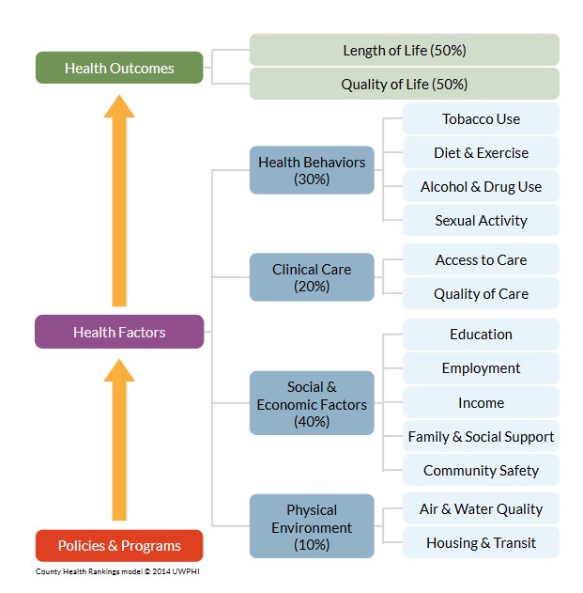
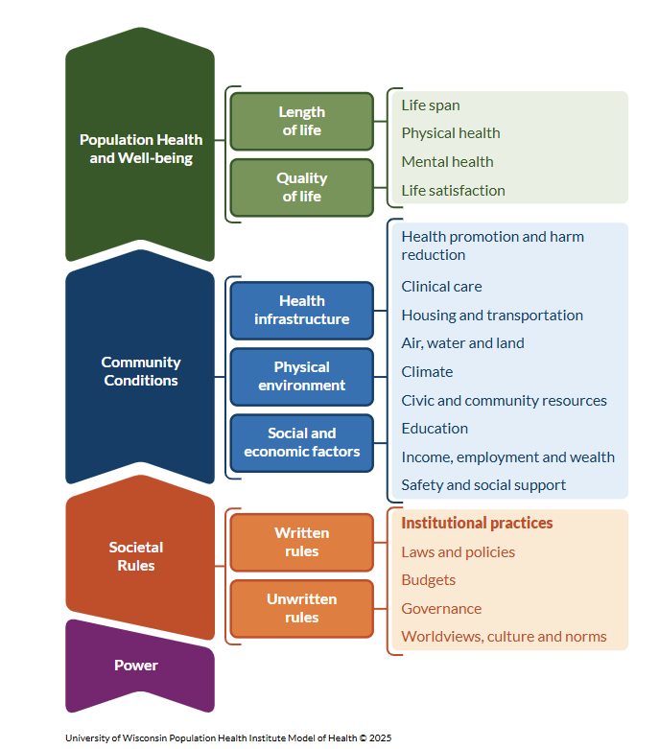
County Health Ranking Model: Risk Factors in Coal County
Coal County faces significant health risks with limited access to exercise (46%), restricting preventive physical activity.
A high uninsured rate (19%) leads to delayed diagnoses and untreated conditions.
Smoking prevalence (24%) surpasses state and national averages, increasing heart disease risk.
Physical inactivity (37%) worsens obesity and cardiovascular conditions.
Low median income ($46,900) limits healthcare access, nutritious food, and healthier lifestyles.
Previous County health Model
Recent Model
https://www.countyhealthrankings.org/strategies-and-solutions/what-works-for-health

Slide 6
Key Factors Contributing to High Male Mortality Rate
Risk Factor | Coal County | Oklahoma | US
Diabetes | 14% | 12% | 10%
Adult Obesity | 43% | 41% | 34%
Access to Exercise Opportunities | 46% | 71% | 84%
Uninsured | 19% | 14% | 10%
Median Household Income | $46,900 | $62,100 | $77,700
Excessive Drinking | 14% | 15% | 19%
Adult Smoking | 24% | 16% | 13%
Physical Inactivity | 37% | 29% | 23%
High Adult Smoking Rate (24%)
Men generally smoke at higher rates than women, and smoking is a leading cause of heart disease and stroke.
This could explain why male mortality rates are particularly high in this county.
Obesity
Men are more prone to abdominal obesity, which is strongly linked to heart disease.
Low exercise opportunities (46%) & Physical Inactivity (43% & 37%) further worsen the situation.
https://www.countyhealthrankings.org/strategies-and-solutions/what-works-for-health

Slide 7
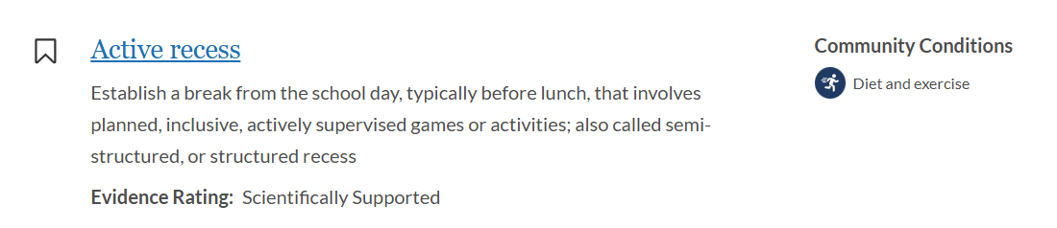
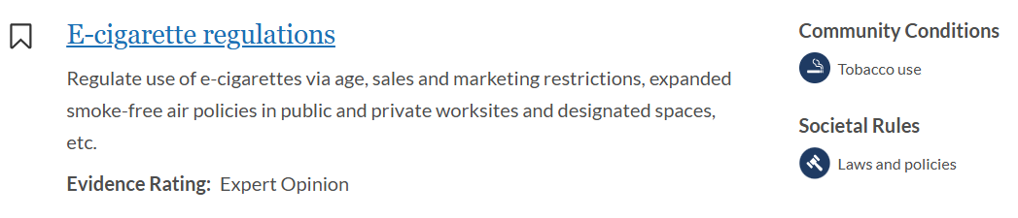
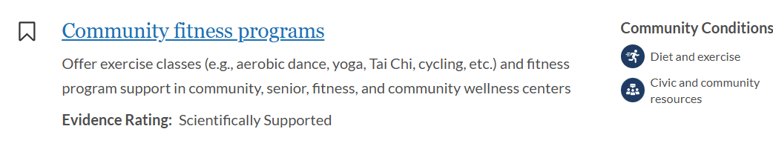
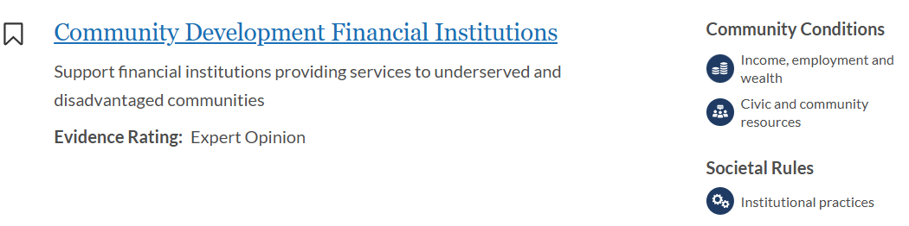
Research Objective: Evidence based Intervention
Expand Access to Exercise – Build community fitness programs, walking trails, and subsidized gym memberships to combat low exercise opportunities (46%).
Implement Smoking Cessation Programs – Provide free tobacco cessation support, nicotine replacement therapy, and public awareness campaigns to reduce high smoking rates (24%).
Improve Healthcare Access – Increase low-cost clinics, mobile screenings, and telehealth services to support the 19% uninsured population.
Enhance Nutrition Programs – Offer subsidized healthy food options, nutrition education, and school meal programs to address low income ($46,900) and obesity (43%).
https://www.countyhealthrankings.org/strategies-and-solutions/what-works-for-health

Slide 8
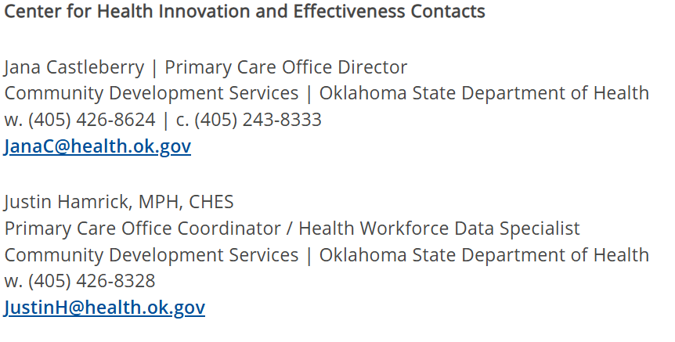
Whom to reach out ?

Slide 9

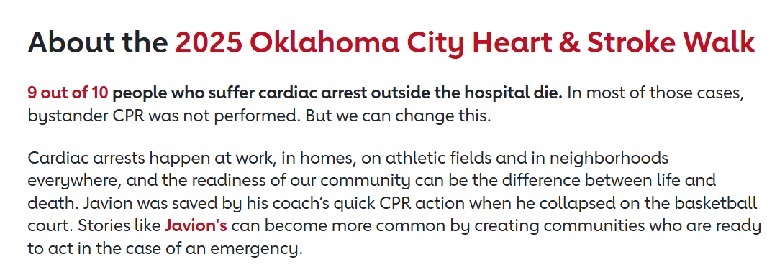
Oklahoma Initiatives towards Ischemic heart Intervention
https://www2.heart.org/site/TR;jsessionid=00000000.app30015a?fr_id=11397&pg=entry&NONCE_TOKEN=1E0A3DA9937EEF8EC2FE1B55C9554FD4

Slide 10
Key Takeaway
Coal County has the highest crude mortality rate (CMR) for both males and females in Oklahoma.
It also holds the overall highest CMR across the entire state.
Males have a higher CMR than females in Coal County.
Updated County Health Ranking Model identifies high smoking rates, uninsured adults, inactive lifestyles, lower median household income, and limited exercise access as major risk factors for ischemic heart disease (IHD) prevalence.
The Center for Health Innovations and Effectiveness in Oklahoma can be a key resource for intervention strategies.
The American Heart Association's Oklahoma City Heart & Stroke Walk is an important initiative promoting heart health awareness and prevention.

Slide 11

Thank You!

